Slide 1

ENGINEERING CHEMISTRY-II
By-chandana MN
ASSIGNED BY- PROF.PRIYARANJINI RAO

Slide 2
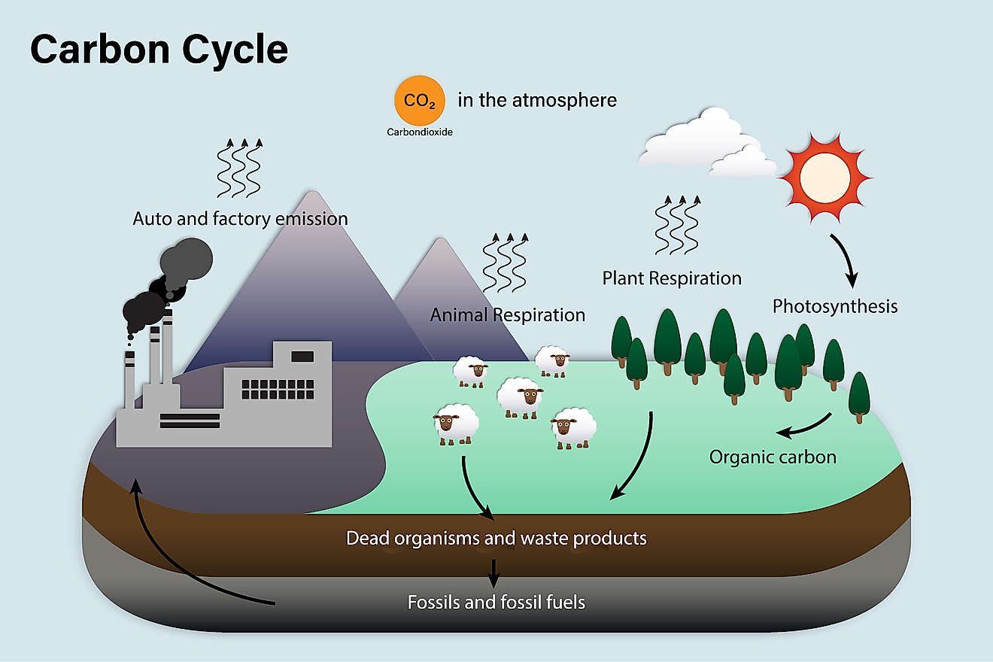
carbon cycle

Slide 3
Introduction to carbon
Carbon is the chemical backbone of life on Earth.
Carbon is the foundation of all life on Earth, required to form complex molecules like proteins and DNA.
Carbon is also found in our atmosphere in the form of carbon dioxide (CO2).
Carbon helps to regulate the Earth’s temperature, makes all life possible
It is a key ingredient in the food that sustains us, and provides a major source of the energy to fuel our global economy.

Slide 4
carbon cycle
It is a form of gaseous cycle.
It is describes as the process in which carbon atoms continually travel from the atmosphere to the Earth and then back into the atmosphere.

Slide 5
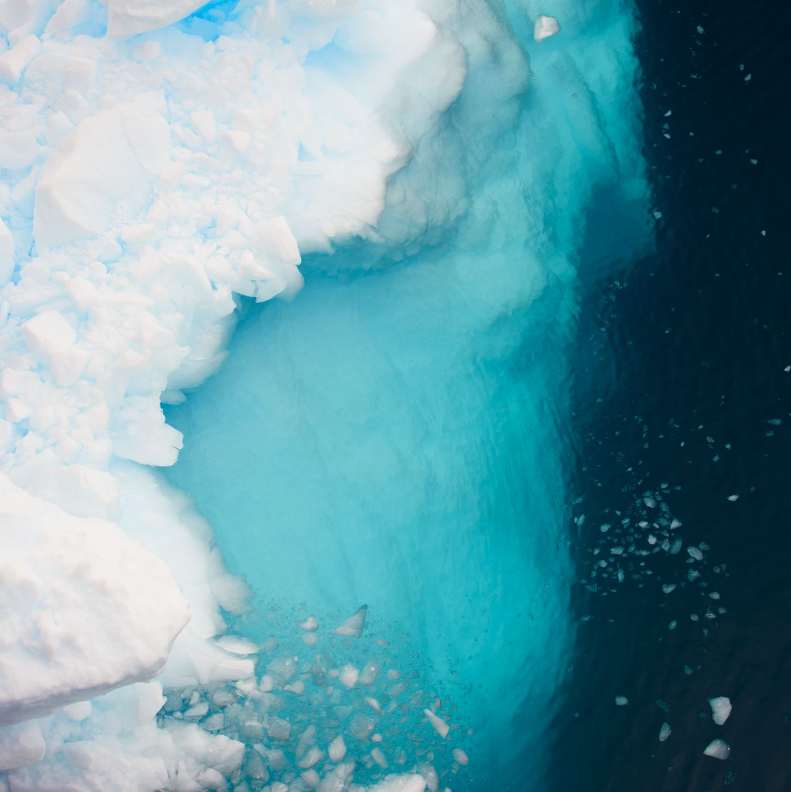
Reservoirs or sinks of carbon
On Earth, most carbon is stored in rocks and sediments, while the rest is located in the ocean, atmosphere, and in living organisms.
These are the reservoirs or sinks, through which carbon cycles continuously takes place.

Slide 6
Release of carbon
Carbon is released back into the atmosphere when organisms die, volcanoes erupt, fires blaze, fossil fuels are burned, and through a variety of other mechanisms.
In the case of the ocean, carbon is continually exchanged between the ocean’s surface waters and the atmosphere, or is stored for long periods of time in the ocean depths.
Humans play a major role in the carbon cycle through activities such as the burning of fossil fuels or land development. As a result, the amount of carbon dioxide in the atmosphere is rapidly rising

Slide 7
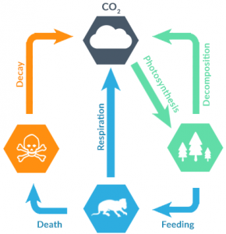
steps of the carbon cycle
Photosynthesis
Decomposition
Respiration
Combustion.

Slide 8
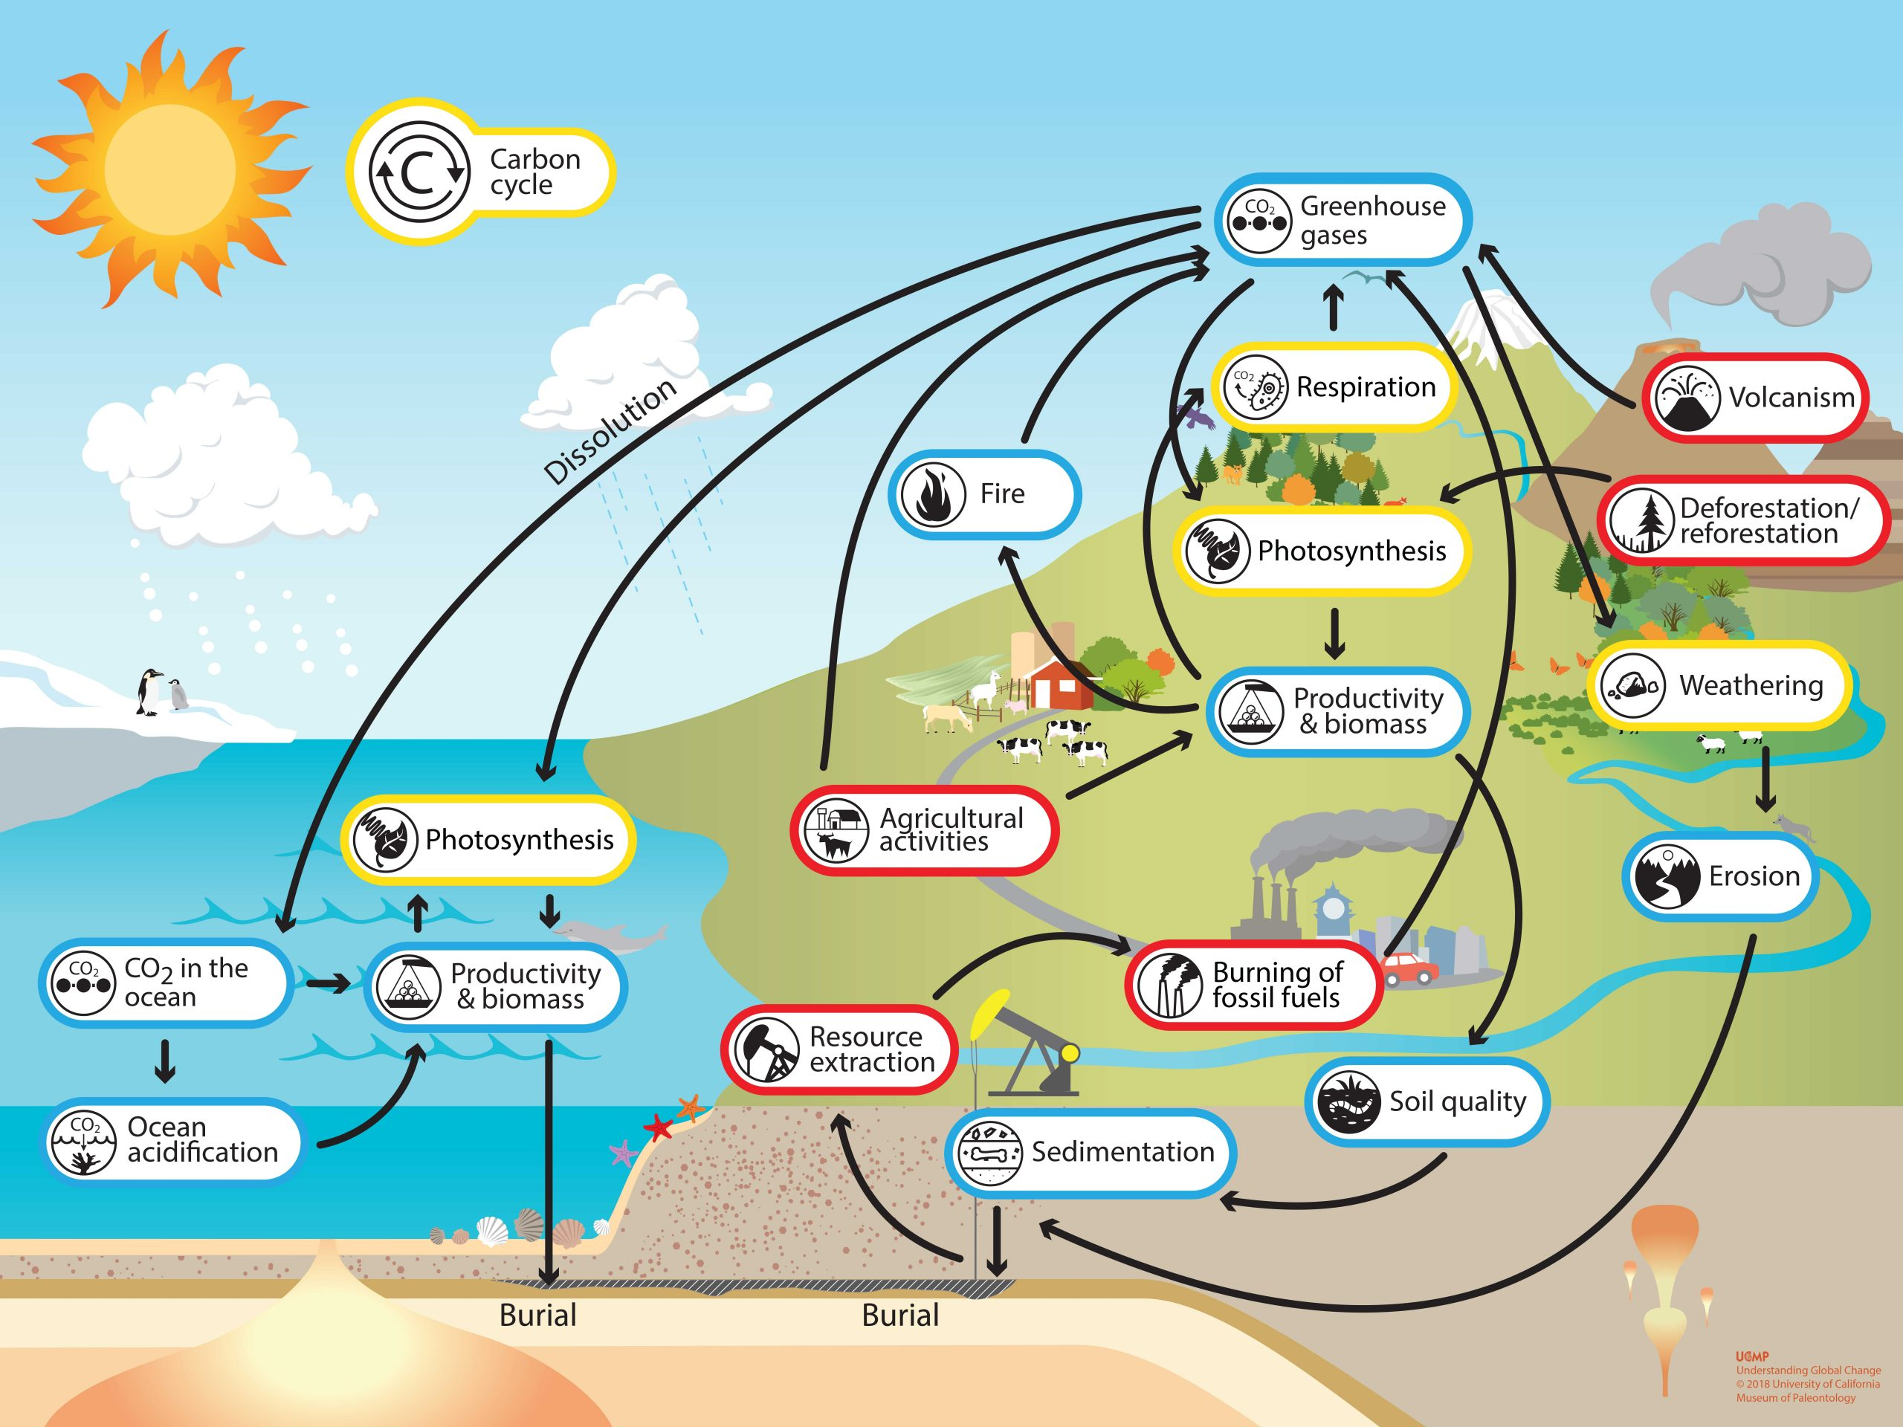

Slide 9


